Slide 1



Coupon Acceptance on
E-commerce Platforms
a predictive model
A predictive model to enhance e-commerce coupon distribution by accurately forecasting user acceptance based on driving scenarios and user attributes, thereby improving engagement and marketing efficiency.

Slide 2
Overview
Columns
Rows
Target
25
12684
Accept(Y/N?)
Input Features
destination, passanger, weather, temperature, coupon, expiration, gender, age, maritalStatus, has_children, education, occupation, income,car,Bar,CoffeeHouse, CarryAway, RestaurantLessThan20, Restaurant20To50, toCoupon_GEQ5min, toCoupon_GEQ15min, toCoupon_GEQ25min, direction_same, direction_opp

Slide 3


Data Inspection
Basic Summary
Several input features contains null values
Addressed input feature inconsistency by converting certain features from object type to numeric type.
Dataset Description

Slide 4


Data Cleaning
Null values
Handled Null values for these features:
‘car’,'Bar','CoffeeHouse','CarryAway','RestaurantLessThan20','Restaurant20To50'
Duplicates
Handled 291 duplicate records.
Input feature ‘car’ has 12576 null data point, due to the importance of this feature filled the null values with ‘unknown’

Slide 5


Ordinal,
OneHot, Label, Frequency
Encoding
Data Preprocessing
and
Feature Engineering
Resampling
SMOT
Scaling
Standard Scalar

Slide 6
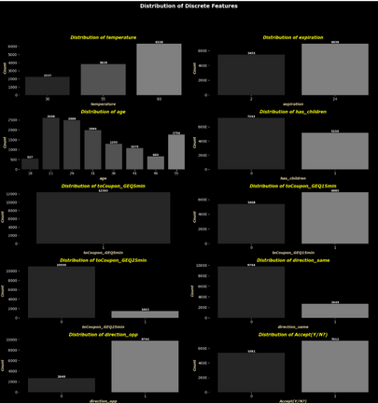
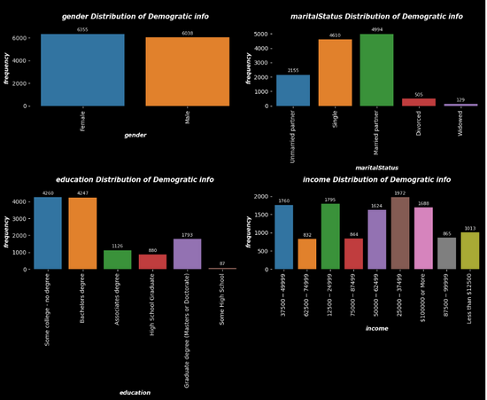
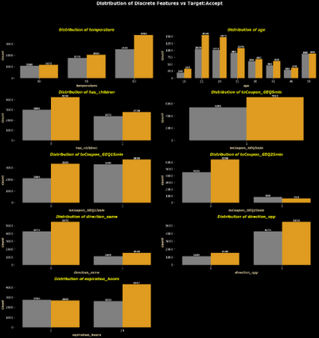
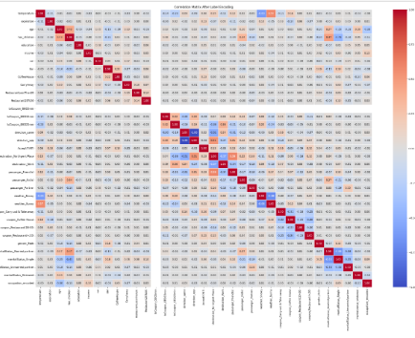

Exploratory Data Analysis
Univariate: Discrete
Univariate: Categorical
Bivariate
Multivariate
Distribution of Discrete Features using Countplot
Distribution of Categorical Features using Countplot, Donut and Pie plots.
Count plot used to represent the relationship between input features and target.
Heatmap used to represent the correlation matrix

Slide 7




Model Selection
01
02
03
04
05
Logistic Regression
Decision Tree
Adaboost
RandomForest
XGBoost
baseline model to understand the dataset
It can handle non-linear relationships and interactions between features
Checking the accuracy by adding weak learners sequentially
To improve generalization compared to a single Decision Tree
To achieve the best performance by leveraging gradient boosting techniques

Slide 8







Model Training and Evaluation
Evaluation metrics
classification_report,confusion_matrix, ConfusionMatrixDisplay
Data splitting
80:20
Hyperparameter Tuning
GridSearchCV

Slide 9
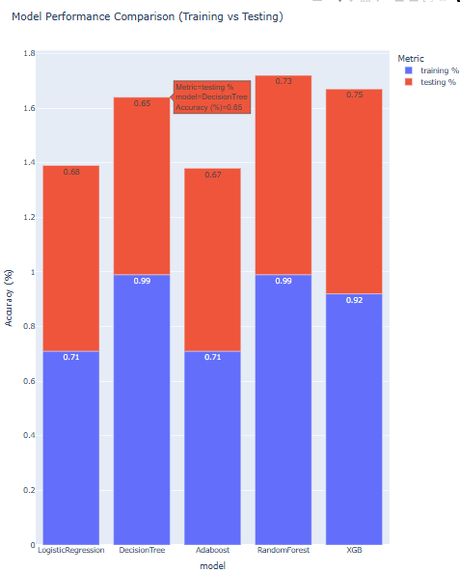

Model Performance
Logistic Regression
training accuracy: .71
testing accuracy: .68
Decision Tree
training accuracy: .99
testing accuracy: .65
Adaboost
training accuracy: .71
testing accuracy: .67
Random Forest
training accuracy: .99
testing accuracy: .73
XGBoost
training accuracy: .92
testing accuracy: .75

Slide 10

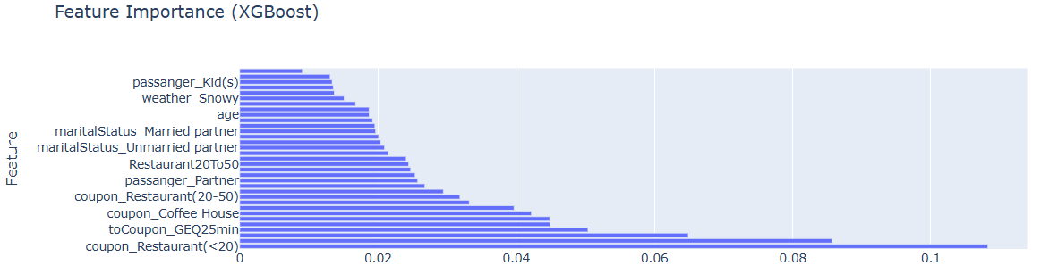
Feature Importance from XGB

Slide 11



Key Findings
Best Model
XGB
Best Features
coupon_Restaurant(<20), coupon_Carry out & Take away, direction_opp, toCoupon_GEQ25min, direction_same,destination_No Urgent Place, coupon_Coffee House, expiration

Slide 12

THANK TOU
For watching this presentation
JITHIN MB

